Slide 1
Penn Liberty Motors
Philadelphia, PA
www.libertymotorspa.com

Slide 2
Our Location
Located in Center City Philadelphia
The City of Our Founding Fathers
Convenient to:
Public Transportation
Historic Attractions
Plenty of Free Parking

Slide 3
Liberty Bell Center
Video Presentations
Exhibits

Slide 4
Independence National Park
Visit Cradle of Liberty
Tour Independence Hall
Visit Independence Living History Center

Slide 5

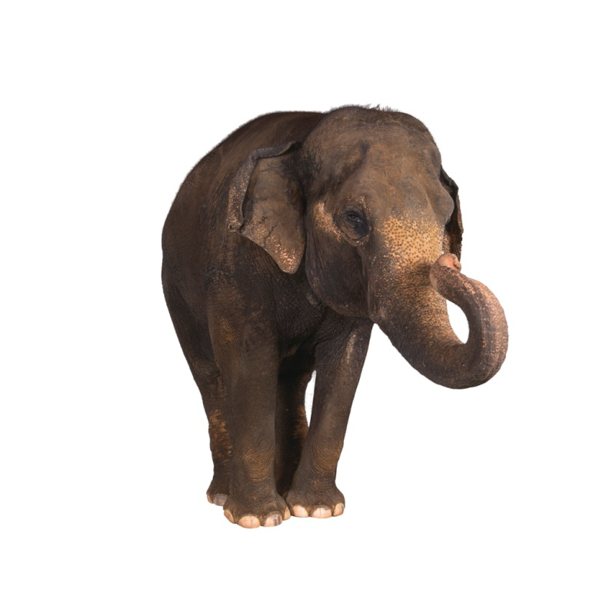
Philadelphia Zoo
Rides and Attractions
Exotic Animals
Conservation Programs

Slide 6
Discount Tickets
Contact Us
Penn Liberty Motors offers discount
tickets to these locations:
National Constitution Center
United States Mint
Independence National Park
Philadelphia Zoo

Slide 7
Penn Liberty Motors
Located in the Cultural Area of the City
Convenient to
Public Transportation
Museums
Exhibitions
Plenty of Free Parking

Slide 8
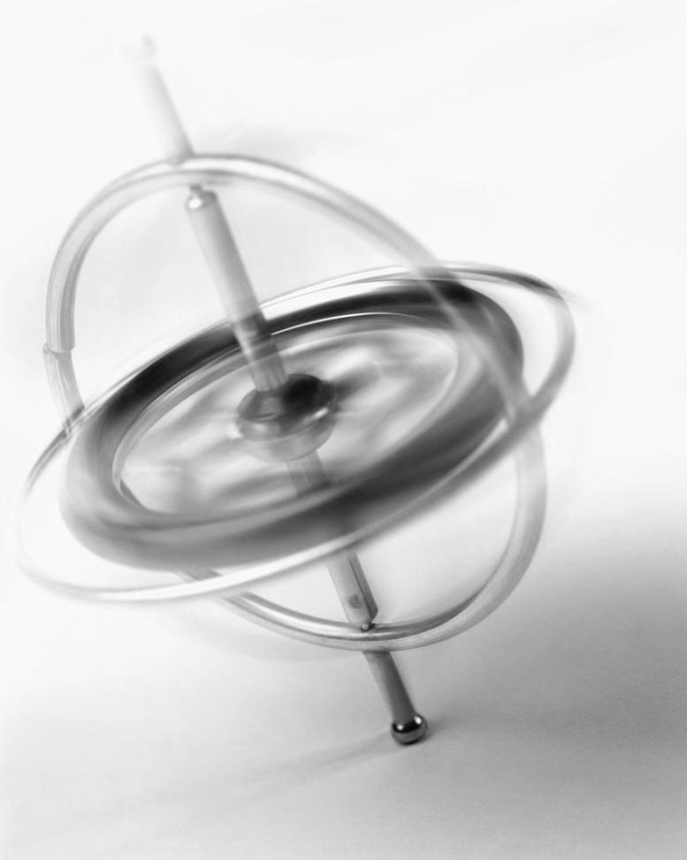
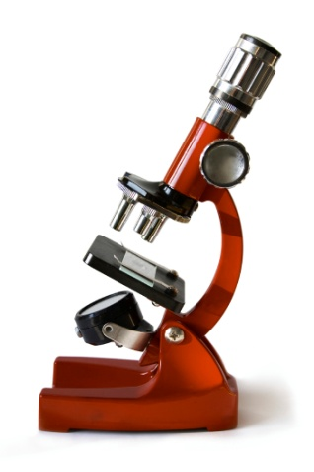
Franklin Institute
Exhibits
Planetarium
Educational Programs
IMAX Theater

Slide 9

Philadelphia Museum of Art
American Crafts
European Art
Architecture
Museum Library

Slide 10
Rodin Museum
Works of Auguste Rodin
Original Sketchbook
Spectacular Gardens

Slide 11


Please Touch Museum
Story Garden
Theater
Kid’s Store

Slide 12

Treat Yourself to a New Car

